Slide 1
Cloning Vectors for Plants
Notes:
http://www.biologydiscussion.com/genetics/engineering/methods-of-gene-transfer-in-plants-2-methods/10824

Slide 2
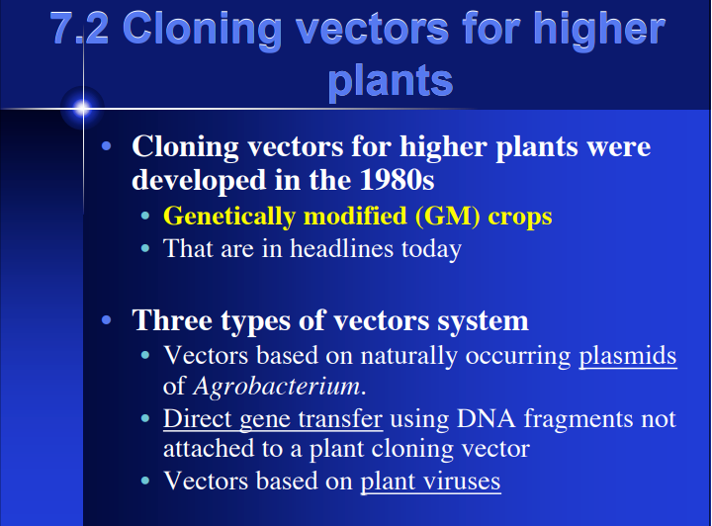

Slide 3
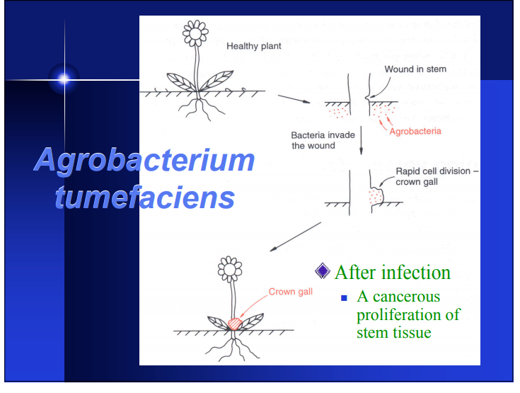

Slide 4
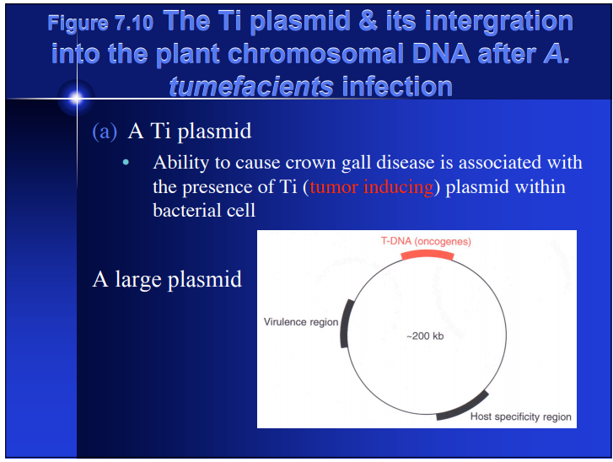

Slide 5
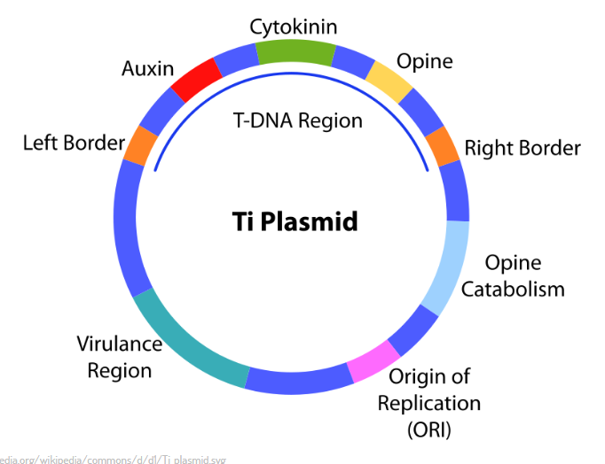

Slide 6
Virulence region
Genes in the virulence region are grouped into the operons virABCDEFG, which code for the enzymes responsible for mediating transduction of T-DNA to plant cells.^{[22]}
· virA codes for a receptor which reacts to the presence of phenolic which leak out of damaged plant tissues.^{[24]}
· virB encodes proteins which produce a pore/pilus-like structure.^{[23]}
· virC binds the overdrive sequence, a T-DNA transfer enhancer.^{[23]}
· virD1 and virD2 produce endonucleases which target the direct repeat borders of the T-DNA segment,
· vir E Binds to T-strand protecting it from nuclease attack, and intercalates with lipids to form channels in the plant membranes through which the T-complex passes, ^{[23]} beginning with the right border.^{[24]}
· virG (TRANSCRIPTIONAL FACTOR) activates vir-gene expression after binding to a consensus sequence,^{[23]} once it has been phosphorylated by virA.^{[24]}
Notes:
http://vle.du.ac.in/mod/book/view.php?id=11901&chapterid=23641
Genes in the virulence region are grouped into the operons virABCDEFG, which code for the enzymes responsible for mediating transduction of T-DNA to plant cells.^{[22]}
· virA codes for a receptor which reacts to the presence of phenolic which leak out of damaged plant tissues.^{[24]}
· virB encodes proteins which produce a pore/pilus-like structure.^{[23]}
· virC binds the overdrive sequence, a T-DNA transfer enhancer.^{[23]}
· virD1 and virD2 produce endonucleases which target the direct repeat borders of the T-DNA segment,
· vir E Binds to T-strand protecting it from nuclease attack, and intercalates with lipids to form channels in the plant membranes through which the T-complex passes, ^{[23]} beginning with the right border.^{[24]}
· virG (TRANSCRIPTIONAL FACTOR) activates vir-gene expression after binding to a consensus sequence,^{[23]} once it has been phosphorylated by virA.^{[24]}

Slide 7
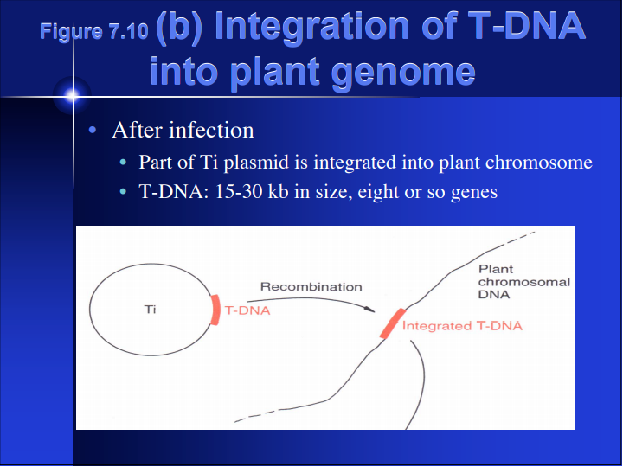

Slide 8
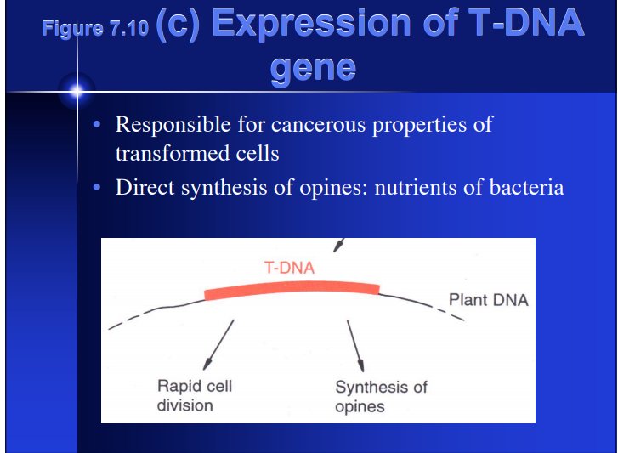

Slide 9
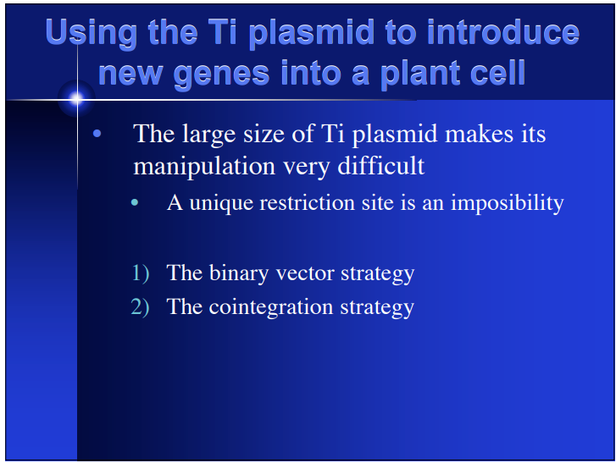

Slide 10
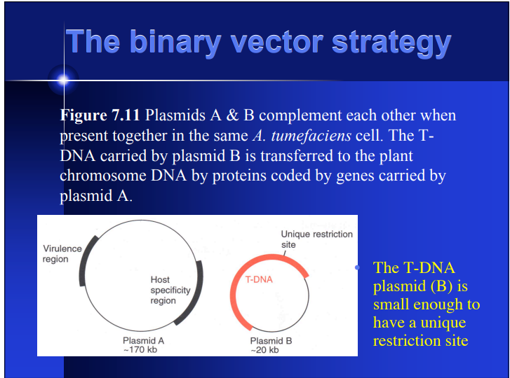

Slide 11
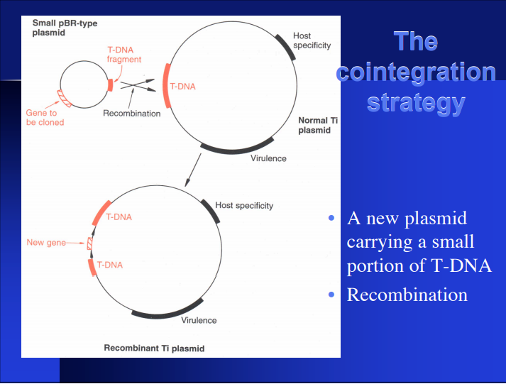

Slide 12
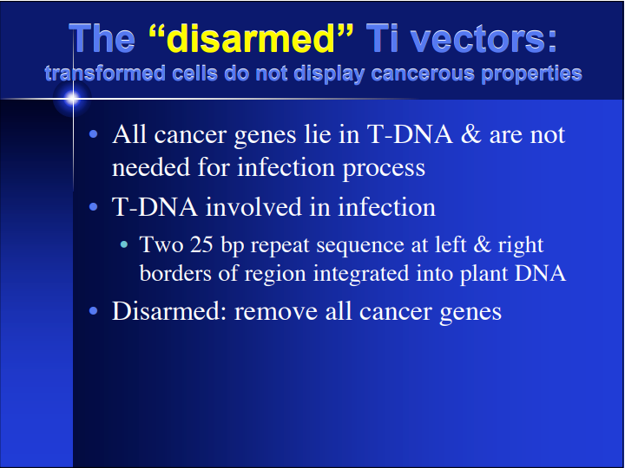

Slide 13
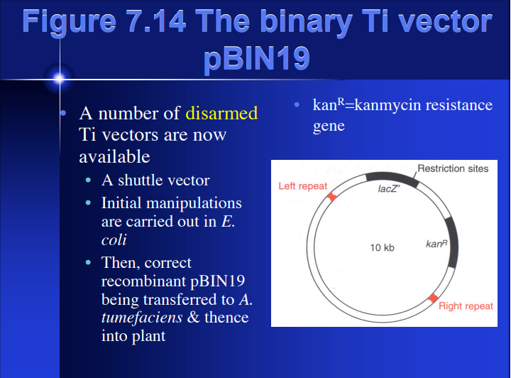

Slide 14
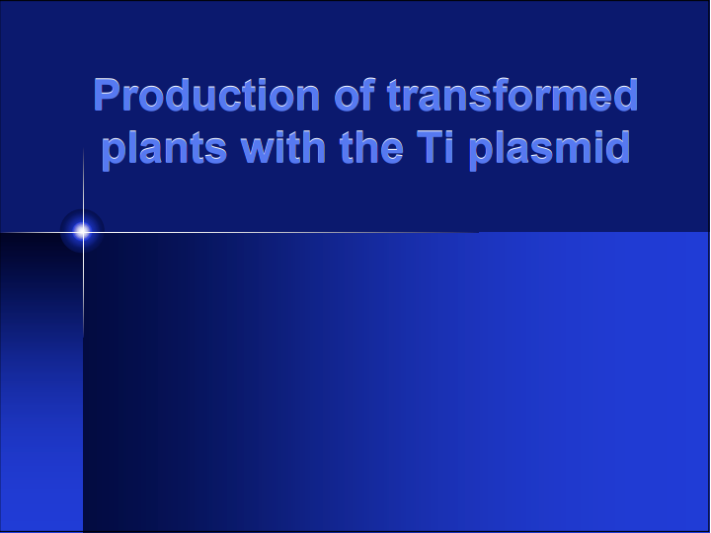

Slide 15
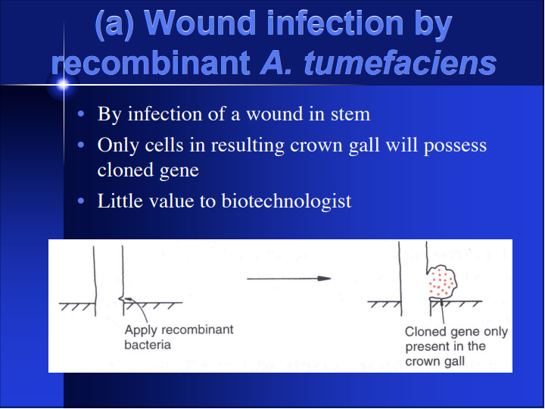

Slide 16
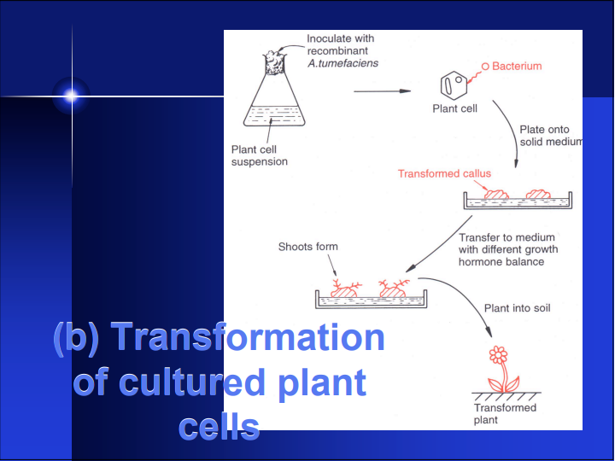

Slide 17
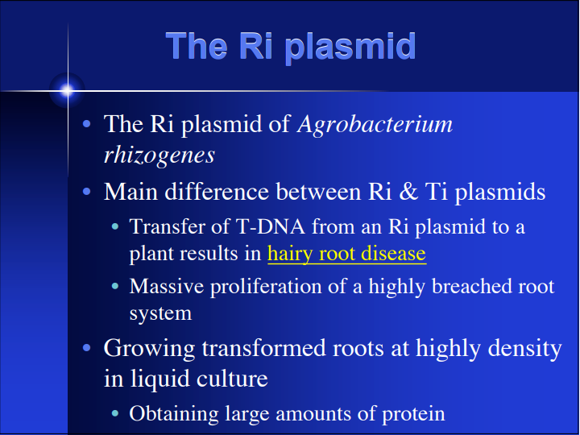

Slide 18
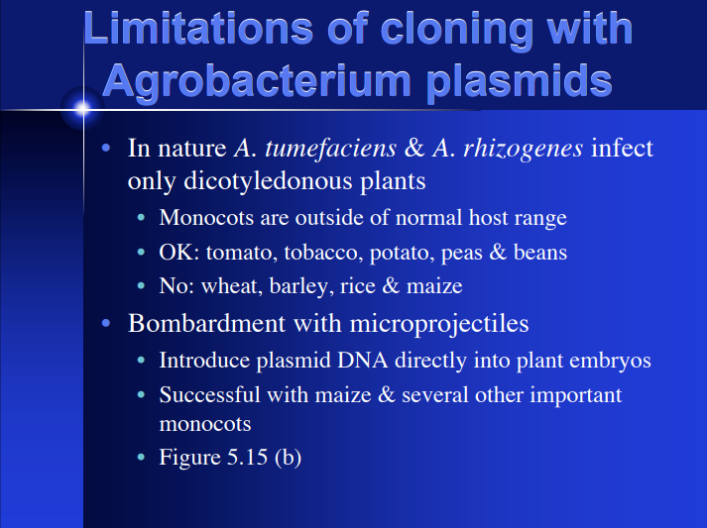

Slide 19
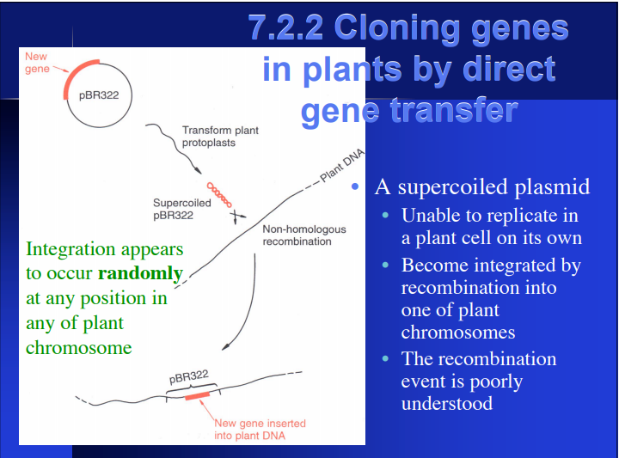

Slide 20
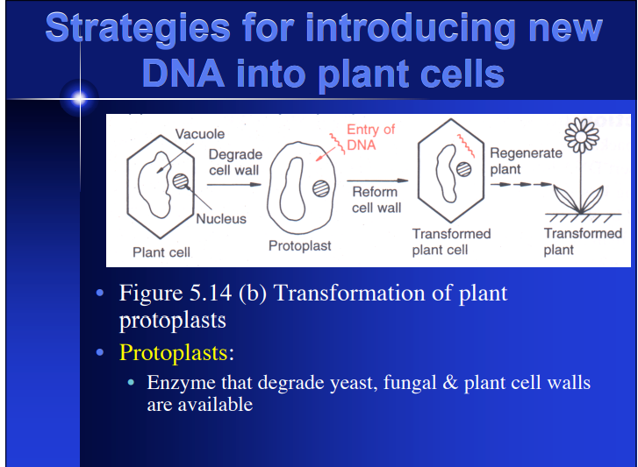

Slide 21
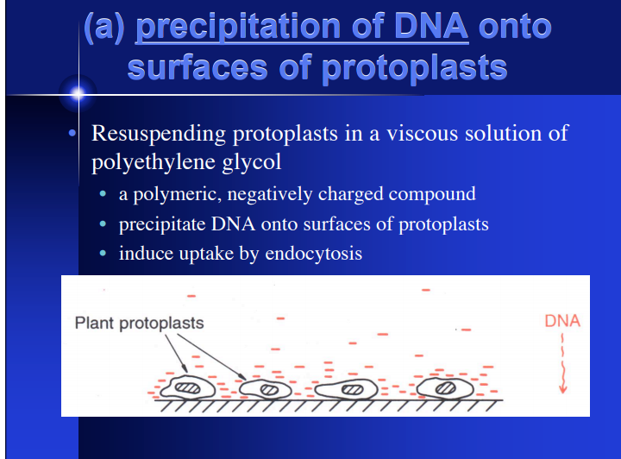

Slide 22
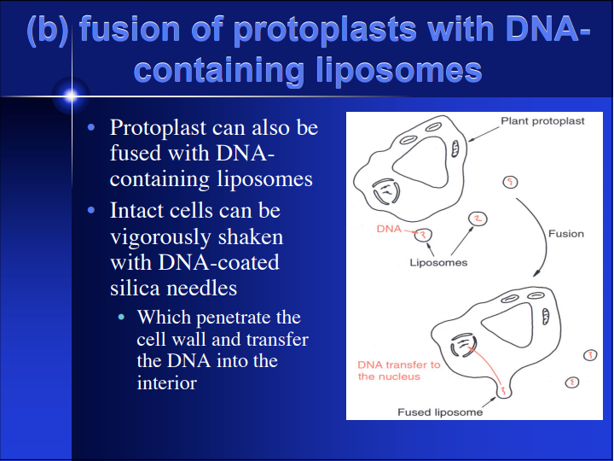
http://vle.du.ac.in/mod/book/print.php?id=11914&chapterid=23696

Slide 23
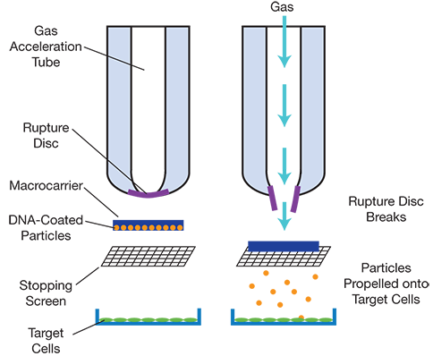
Biolistic
In biolistic delivery, genes are coated and dehydrated onto heavy-metal particles, such as gold or tungsten. High-pressure helium pulses accelerate the particles, propelling them into plant cells at high velocities (Figure 2). Typically, the epidermal tissue of plant cells is targeted. Depending on the experimental parameters, DNA can pass through both the plant cell wall and plasma membrane, and can also penetrate into the nucleus (2). Helium gas pressure, net particle size, and dosing frequency are critical experimental parameters that determine the penetration efficiency, toxicity, and overall gene transfer levels in plants.
Notes:
https://www.aiche.org/resources/publications/cep/2017/april/delivering-genes-plants

Slide 24
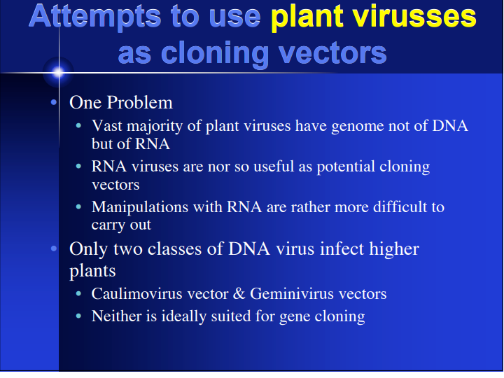
Caulimovisrus- size, narrow host range, Geminivirus- rearrangement or deletion of added DNA, not stable
Notes:
http://www.biologydiscussion.com/viruses/plant-viruses/plant-viruses-as-vectors-genetics/71983

Slide 25
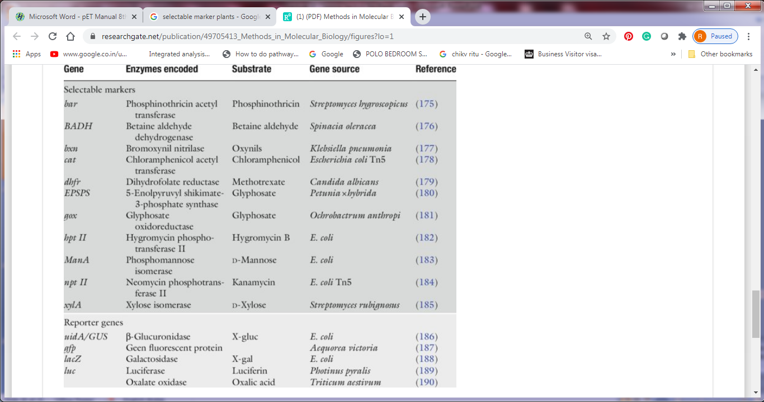
Various selectable markers and reporter genes commonly used in transgenic plants

Slide 26
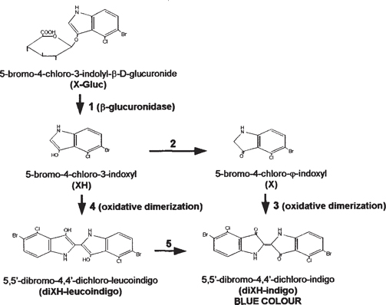
GUS Assay

Slide 27
